Slide 1

AI and the Environment 3:
Decision Trees

Slide 2
Decision Trees
Decision Trees are an elegant machine learning algorithm which have a great balance between explainability and learning ability.
They work very much like how they sound.
Your data is categorised based on its groups and is passed to one or other node of a decision tree.
Picture it like a flow chart.

Slide 3
Decision Trees
Based on categories is it a mammal?
Animal
No
Fluffy?
No
Feathers
No
Mammal

Slide 4
Decision Trees
Animal
They are heavily favoured in explainability as you can
see exactly why each decision was made.
This is particularly helpful in scientific uses where we want to know
the contributing factors to our prediction not just the results.
Often called Classification and Regression Trees or CART.
No
Fluffy?
No
Feathers
No
Mammal

Slide 5
Decision Trees
Animal
This is a very simplistic concept but it follows these
ideas.
First the data is divided into sub groups at each
node and then that is what makes the decision
of which node to advance to.
Deciding how to group is based on the information contained
in the data, and is generally categorised with entropy
No
Fluffy?
No
Feathers
No
Mammal

Slide 6
Decision Trees
Animal
This is a very simplistic concept but it follows these
ideas.
First the data is divided into sub groups at each
node and then that is what makes the decision
of which node to advance to.
Deciding how to group is based on the information contained
in the data, and is generally categorised with entropy
No
Fluffy?
No
Feathers
No
Mammal

Slide 7
Decision Trees
At its heart it is based on the concept of a binary tree
A tree can have either 0, 1 or 2 nodes
Animal
Animal
Animal
No
No
Feathers

Slide 8
Decision Trees
At its heart it is based on the concept of a binary tree
A binary tree can have either 0, 1 or 2 nodes
Some decision tree algorithms allow for more nodes than 2
Animal
Animal
Animal
No
No
Feathers

Slide 9
Decision Trees
So as we build trees what we are doing is essentially dividing the data based on something.
Animal
Animal
Animal
No
No
Feathers

Slide 10
Decision Trees
So as we build trees what we are doing is essentially dividing the data based on something.
We need to think about how to divide data. Which means we need to think about how our data is structured.

Slide 11
Data Structures – Contingency Tables
Lets look at a few hypothetical data structures.
It’s easy to imagine how to split categorical data like our fluffy or not fluffy

Slide 12
Data Structures – Contingency Tables
This data is a count of the two different values.
Normally you would call this a histogram in ML / computer science it is often referred to as a contingency table or more specifically a histogram is a 1 dimensional contingency table.

Slide 13
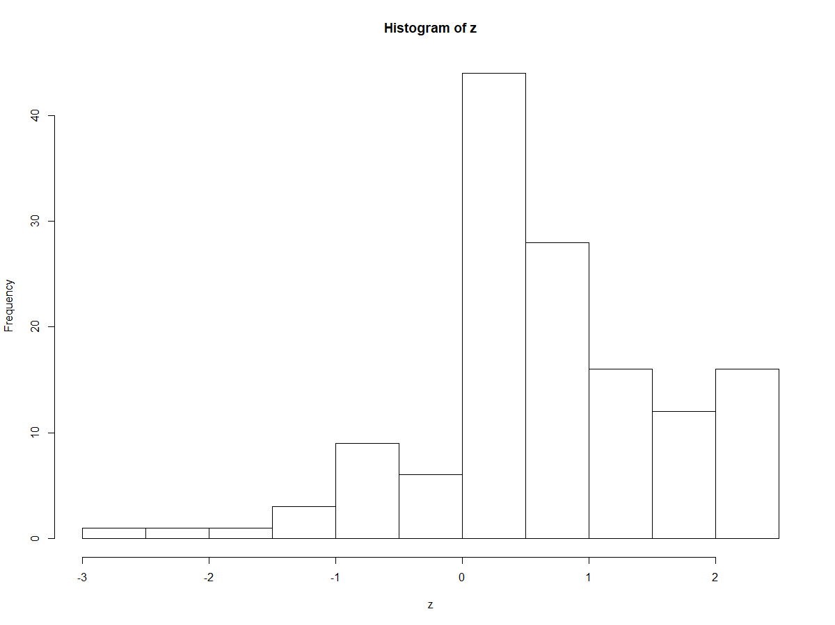
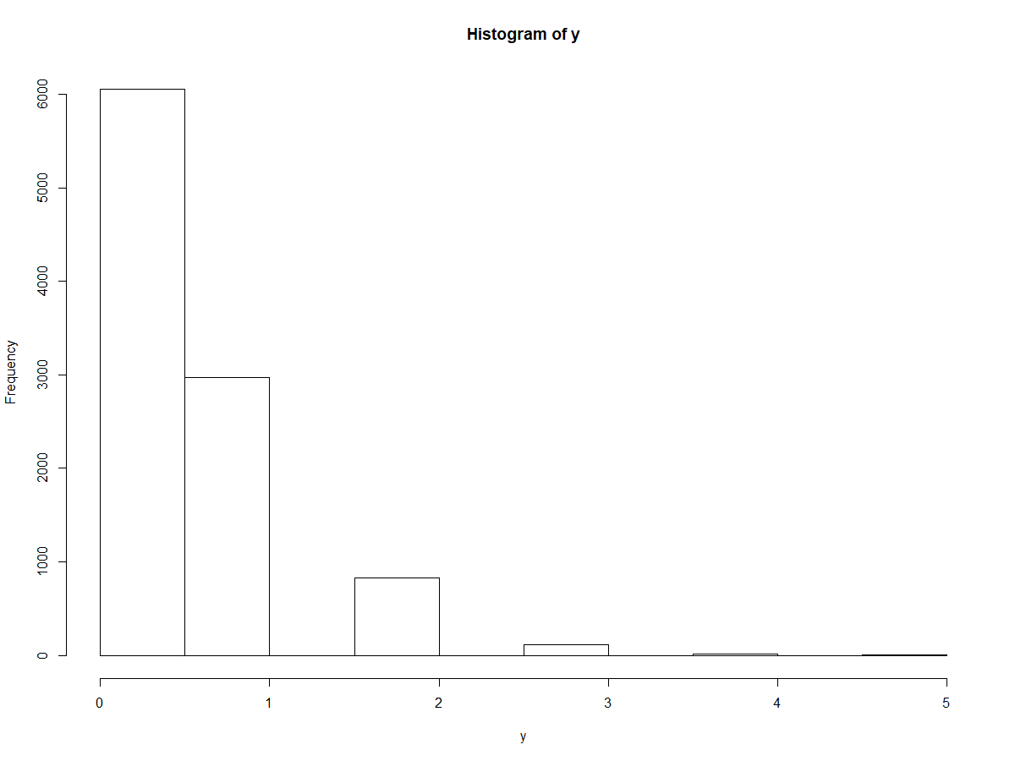
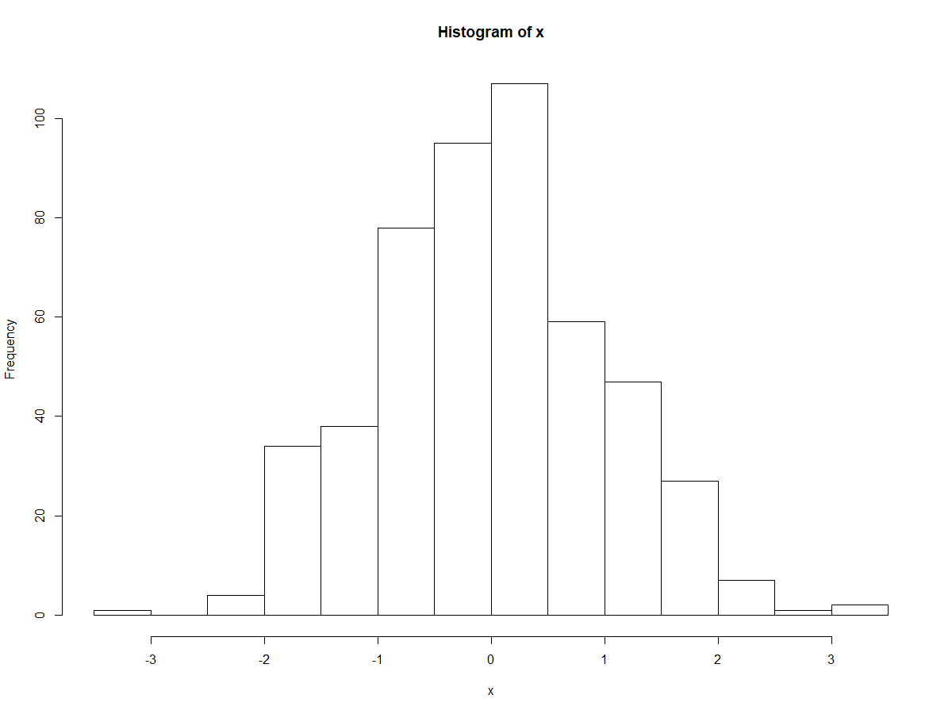
Data Structures – Data
Lets look at a few hypothetical data structures.
But how about some continuous variables

Slide 14
Data Structures – Data
??
There are a few easy ways but with some data it is not that simple

Slide 15
Decision Trees
Animal
When we go back to our trees what we want our
algorithm to learn on is in fact how it divides the
data
As with linear regression the way we want to divide the data is
to find the separation that minimises the cost.
Depending on how and what you are classifying there are different cost
functions.
No
Fluffy?
No
Feathers
No
Mammal

Slide 16
Decision Trees - GINI
GINI is the major calculator for splitting data.
GINI is what is termed as a greedy algorithm – meaning that it searches through the data all the way blindly trying lots or all of the possible splits
This is low efficiency but requires no prior knowledge of the data.

Slide 17
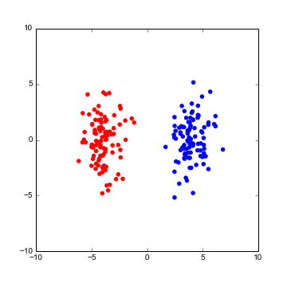
Decision Trees - GINI
GINI works in a supervised way in that it divides up the data with a split and the measures the cost by looking at how many points in the data were misclassified.
Here we have two classes of data.

Slide 18
Decision Trees - GINI
GINI works in a supervised way in that it divides up the data with a split and the measures the cost by looking at how many points in the data were misclassified.
This would be a perfect GINI split giving a score of 0

Slide 19
Decision Trees - GINI
GINI works in a supervised way in that it divides up the data with a split and the measures the cost by looking at how many points in the data were misclassified.
This would be the worst possible GINI score of 0.5 i.e 50% of the data is in the wrong class.

Slide 20
Decision Trees - GINI
GINI works in a supervised way in that it divides up the data with a split and the measures the cost by looking at how many points in the data were misclassified.
We can also weight our score by the proportion of points in each class against the total number of points.

Slide 21
Decision Trees - GINI
First step in calculating GINI is calculating the proportion of points in the group you have made with your split vs the total number that should be in our group and visa versa with wrong.

Slide 22
Decision Trees - GINI
So in this case we have two classes and will end up with 4 proportions.
Proportion classified in group 1 /total group 1 size
Proportion classified in group 2 that should be in 1 / total group 1 size
Proportion classified in group 2 /total group 2 size
Proportion classified in group 1 that should be in 2 / total group 2 size

Slide 23
Decision Trees - GINI
So in this case we have two classes and will end up with 4 proportions.
Proportion classified in group 1 /total group 1 size = 100/100
Proportion classified in group 2 that should be in 1 / total group 1 size = 0/100
Proportion classified in group 2 /total group 2 size = 100/100
Proportion classified in group 1 that should be in 2 / total group 2 size = 0/100

Slide 24
Decision Trees - GINI
We have 4 proportions now
100/100 = 1
0/100 = 0
100/100 = 1
0/100 = 0

Slide 25
Decision Trees - GINI
We have 4 proportions now
G1C= 1
G1I = 0
G2C = 1
G1I = 0

Slide 26

Decision Trees - GINI
Using these proportions we calculated GINI using the formula
G1C= 1
G1I = 0
G2C = 1
G1I = 0
$$GINI= \left(1 − \sum{p^{2}}\right)$$

Slide 27
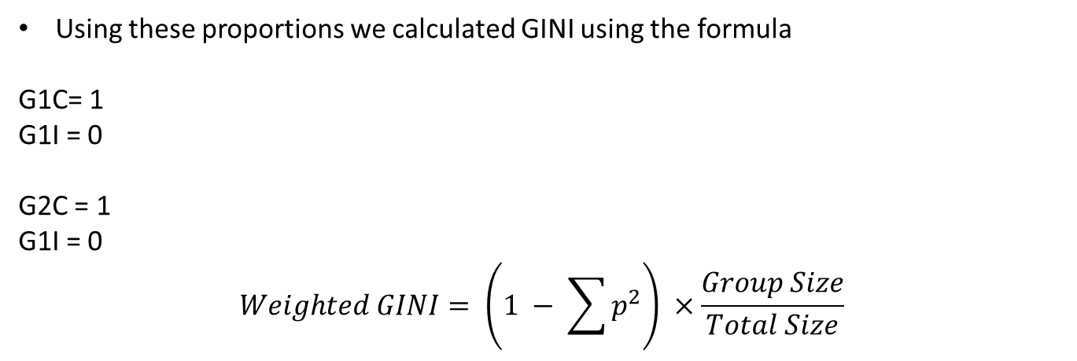
Decision Trees - GINI
Using these proportions we calculated GINI using the formula
G1C= 1
G1I = 0
G2C = 1
G1I = 0
$$Weighted GINI= \left(1 − \sum{p^{2}}\right) ×\frac{Group Size}{Total Size}$$

Slide 28
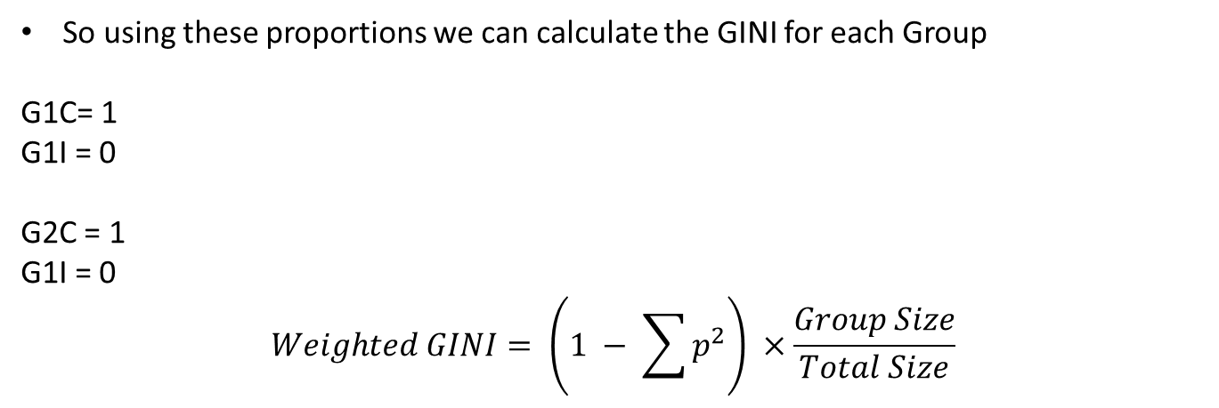
Decision Trees - GINI
So using these proportions we can calculate the GINI for each Group
G1C= 1
G1I = 0
G2C = 1
G1I = 0
$$Weighted GINI= \left(1 − \sum{p^{2}}\right) ×\frac{Group Size}{Total Size}$$

Slide 29
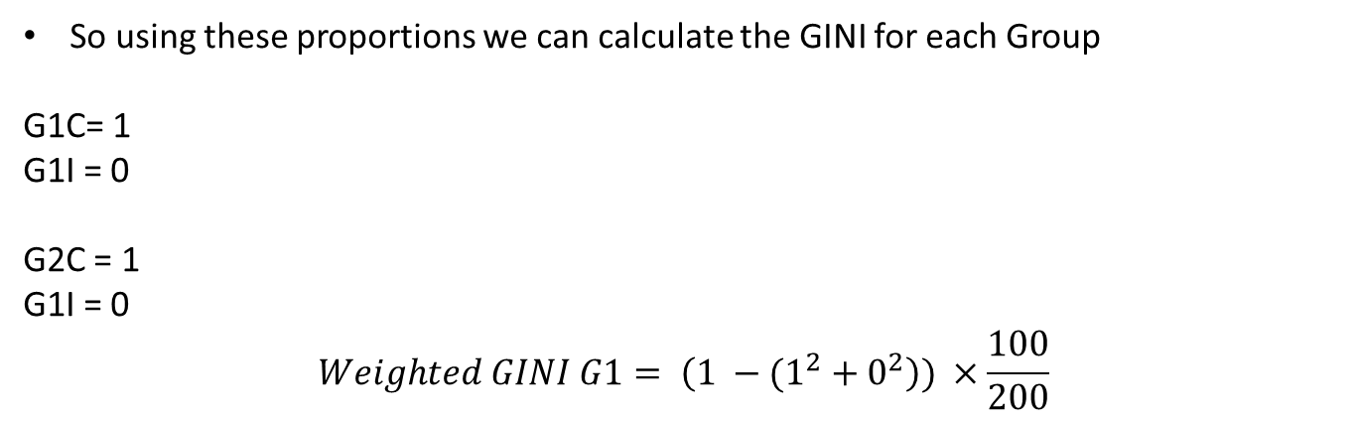
Decision Trees - GINI
So using these proportions we can calculate the GINI for each Group
G1C= 1
G1I = 0
G2C = 1
G1I = 0
$$Weighted GINI G1= \left(1 −(1^{2}+0^{2}\right)) ×\frac{100}{200}$$

Slide 30
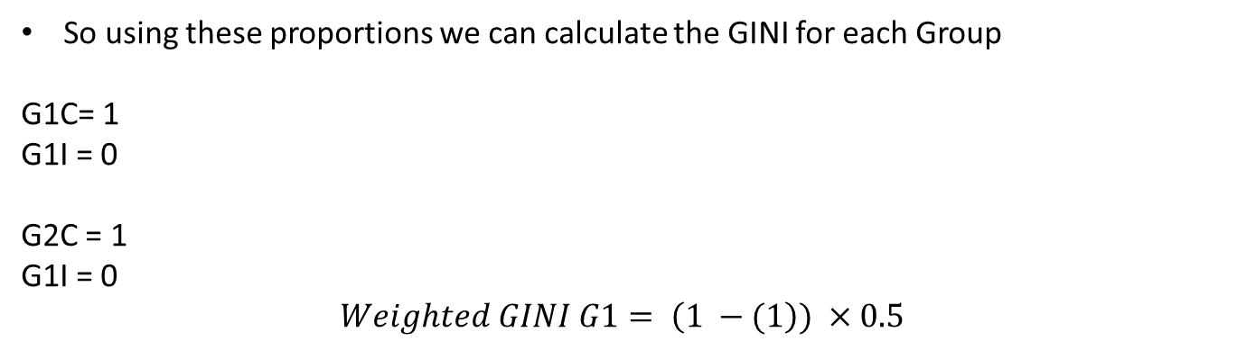
Decision Trees - GINI
So using these proportions we can calculate the GINI for each Group
G1C= 1
G1I = 0
G2C = 1
G1I = 0
$$Weighted GINI G1= \left(1 −(1\right)) ×0.5$$

Slide 31
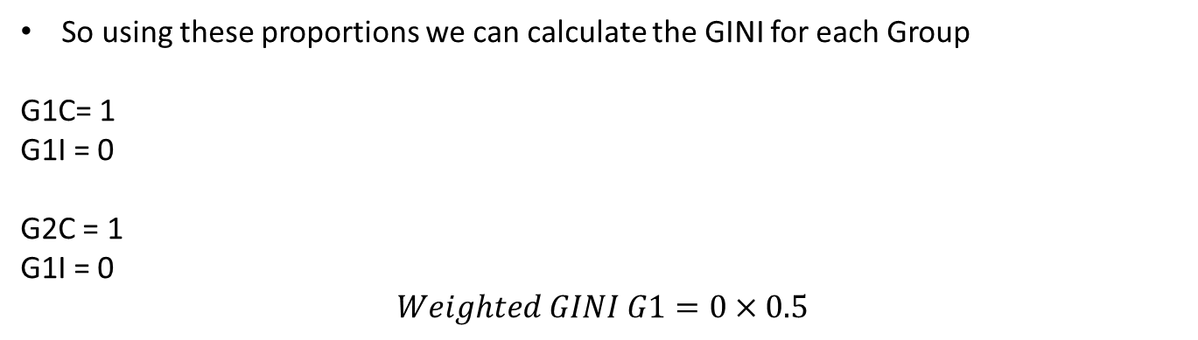
Decision Trees - GINI
So using these proportions we can calculate the GINI for each Group
G1C= 1
G1I = 0
G2C = 1
G1I = 0
$$Weighted GINI G1=0×0.5$$

Slide 32
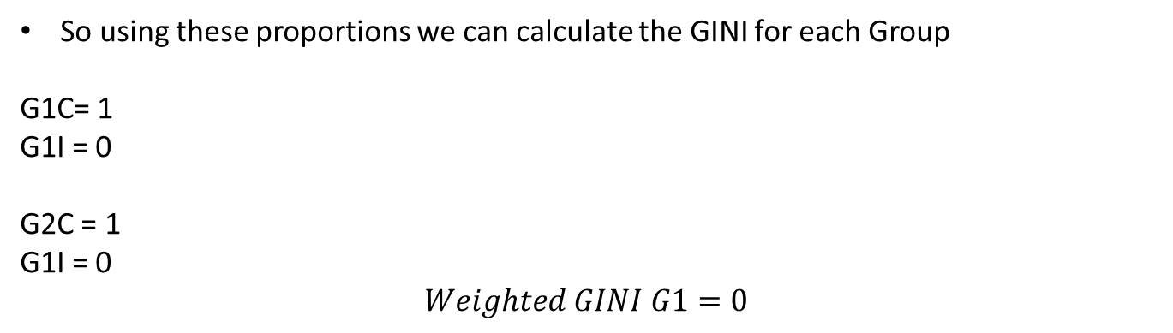
Decision Trees - GINI
So using these proportions we can calculate the GINI for each Group
G1C= 1
G1I = 0
G2C = 1
G1I = 0
$$Weighted GINI G1=0$$

Slide 33
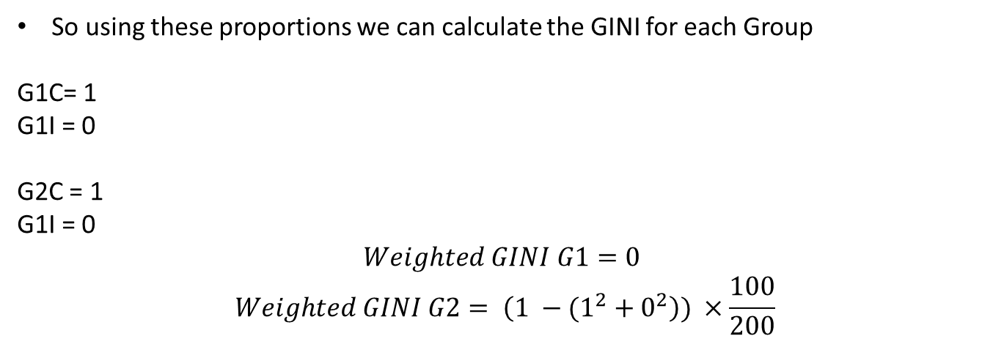
Decision Trees - GINI
So using these proportions we can calculate the GINI for each Group
G1C= 1
G1I = 0
G2C = 1
G1I = 0
$$Weighted GINI G1=0$$
$$Weighted GINI G2= \left(1 −(1^{2}+0^{2}\right)) ×\frac{100}{200}$$

Slide 34
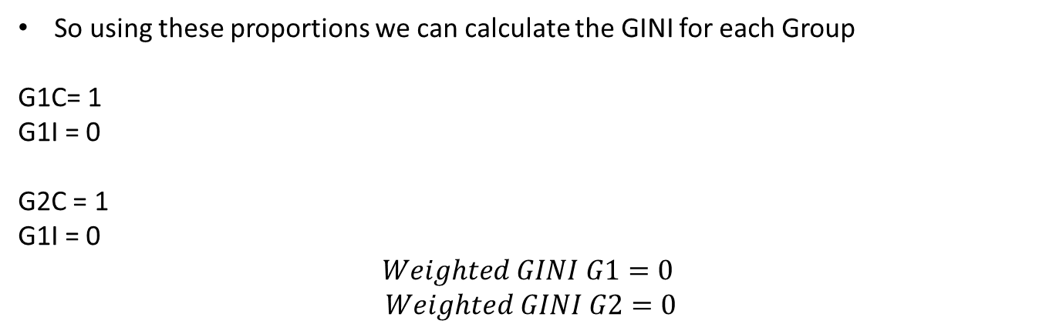
Decision Trees - GINI
So using these proportions we can calculate the GINI for each Group
G1C= 1
G1I = 0
G2C = 1
G1I = 0
$$Weighted GINI G1=0$$
$$Weighted GINI G2=0$$

Slide 35
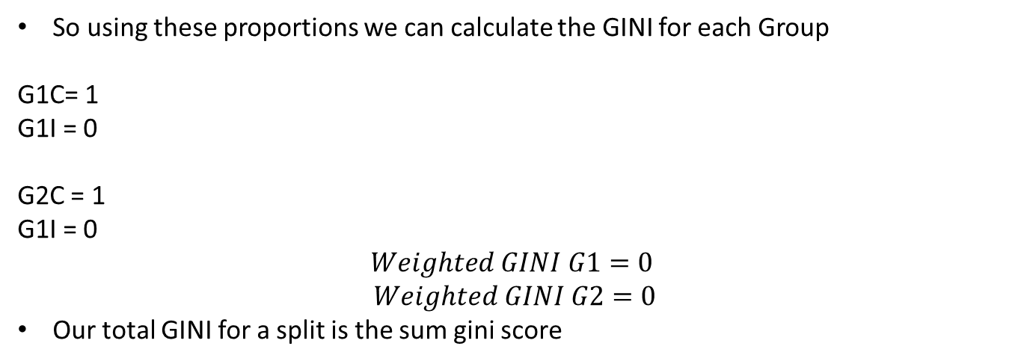
Decision Trees - GINI
So using these proportions we can calculate the GINI for each Group
G1C= 1
G1I = 0
G2C = 1
G1I = 0
$$Weighted GINI G1=0$$
$$Weighted GINI G2=0$$
Our total GINI for a split is the sum gini score

Slide 36
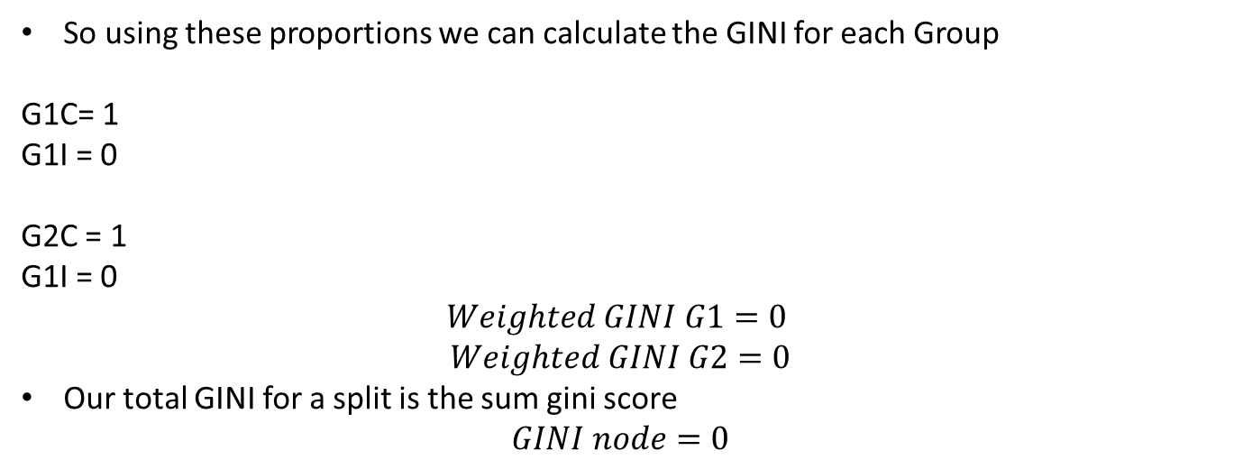
Decision Trees - GINI
So using these proportions we can calculate the GINI for each Group
G1C= 1
G1I = 0
G2C = 1
G1I = 0
$$Weighted GINI G1=0$$
$$Weighted GINI G2=0$$
Our total GINI for a split is the sum gini score
$$GINI node=0$$

Slide 37
Decision Trees - GINI
So with GINI what we have calculated is referred to as the purity of the split or in decision tree terms the node.
Now we know how to split data in a way that minimised a cost we need to know how to construct a tree.

Slide 38
Decision Trees
Now we know how to split data in a way that minimised a cost we need to know how to construct a tree.
This is where our algorithm begins to become computationally expensive.
We start with a dataset and then begin to divide it up trying every possible combination and calculating the GINI for it.

Slide 39
Decision Trees
Once we have the lowest GINI for a split this becomes our first node in the tree.
From then on we need to grow our tree this involves several complicated steps but the first principal is deciding on how big we are going to build our tree.

Slide 40
Decision Trees – Terminal Nodes
From then on we need to grow our tree this involves several complicated steps but the first principal is deciding on how big we are going to build our tree.
When to stop building a tree outwards also called a Terminal Node is generally a Hyperparameter with two different kinds:
Maximum Tree Depth – You have specified how deep you want your tree to go.
Minimum Node Records – The minimum amount of data you want any split to be performed on (If you are splitting too small decision trees become prone to overfitting).

Slide 41
Decision Trees – Terminal Nodes
When to stop building a tree outwards also called a Terminal Node is generally a Hyperparameter with two different kinds:
Maximum Tree Depth – You have specified how deep you want your tree to go.
Minimum Node Records – The minimum amount of data you want any split to be performed on.
There is the final and obvious reason to stop which is if you can only split everything into a single group.
At this point it is impossible to split the data any further and the tree ends there.

Slide 42
Decision Trees
So now we know where to start our tree (called the root node) and where to end our tree ( The terminal nodes) we just have to begin splitting from the start until we hit our end point.
This is called recursive splitting and it creates nodes at each split which have child or parent nodes:
Animal
Root Node
No
Fluffy?
Terminal Node

Slide 43
Decision Trees
So now we know where to start our tree (called the root node) and where to end our tree ( The terminal nodes) we just have to begin splitting from the start until we hit our end point.
This is called recursive splitting and it creates nodes at each split which have child or parent nodes:
Animal
Parent Node
No
Fluffy?
Child Node

Slide 44
Decision Trees
So now we know where to start our tree (called the root node) and where to end our tree ( The terminal nodes) we just have to begin splitting from the start until we hit our end point.
Each node can have 0 ,1 or 2 child nodes: If it has 0 it is a terminal node, if it has 1 it has created a terminal node that makes predictions and 2 it will carry on splitting.
Root Node
Terminal Node
Child Node
Terminal Node with prediction.

Slide 45
Decision Trees
Tree nodes are referred to as either left or right. And it is generally common practice to go down the left nodes first.
Step 1: split data to create root node

Slide 46
Decision Trees
Tree nodes are referred to as either left or right. And it is generally common practice to go down the left nodes first.
Step 1: split data to create root node

Slide 47
Decision Trees
Tree nodes are referred to as either left or right. And it is generally common practice to go down the left nodes first.
Step 2: Go to left node and check that it a) contains data b) is not at maximum depth, c) has enough Data

Slide 48
Decision Trees
Tree nodes are referred to as either left or right. And it is generally common practice to go down the left nodes first.
Step 3: If Left node is not Terminal split again

Slide 49
Decision Trees
Tree nodes are referred to as either left or right. And it is generally common practice to go down the left nodes first.
Step 4: Go to new left node and check if it is terminal

Slide 50
Decision Trees
Tree nodes are referred to as either left or right. And it is generally common practice to go down the left nodes first.
Step 5: Go Back up tree and then down into the right node.

Slide 51
Decision Trees
Tree nodes are referred to as either left or right. And it is generally common practice to go down the left nodes first.
Step 5: Go Back up tree and then down into the right node.

Slide 52
Decision Trees
Tree nodes are referred to as either left or right. And it is generally common practice to go down the left nodes first.
Step 6: Check if right node is terminal.

Slide 53
Decision Trees
Tree nodes are referred to as either left or right. And it is generally common practice to go down the left nodes first.
Step 7: Back up the tree.

Slide 54
Decision Trees
Tree nodes are referred to as either left or right. And it is generally common practice to go down the left nodes first.
Step 7: Back up the tree.

Slide 55
Decision Trees
Tree nodes are referred to as either left or right. And it is generally common practice to go down the left nodes first.
Step 8: Now we are back at the root we go down the right nodes.

Slide 56
Decision Trees
Tree nodes are referred to as either left or right. And it is generally common practice to go down the left nodes first.
Step 8: Now we are back at the root we go down the right nodes.

Slide 57
Decision Trees
Tree nodes are referred to as either left or right. And it is generally common practice to go down the left nodes first.
Step 9: Check if node is terminal

Slide 58
Decision Trees
Tree nodes are referred to as either left or right. And it is generally common practice to go down the left nodes first.
Step 10: Split node

Slide 59
Decision Trees
Tree nodes are referred to as either left or right. And it is generally common practice to go down the left nodes first.
Step 11: Check if node is terminal – in this case all the data went into it so it is.

Slide 60
Decision Trees
That’s the process by which a tree is built.
Once a Tree is built predictions can then be made using it.

Slide 61
Decision Trees
A single data entry is passed to the tree and navigates it’s way down it.
Imagine our first Split takes a split like in the histogram on the right

Slide 62
Decision Trees
Values above 0 are passed left and below 0 are passed right.

Slide 63
Decision Trees
Values above 0 are passed left and below 0 are passed right.
If input first value is 1.2

Slide 64
Decision Trees
Values above 0 are passed left and below 0 are passed right.
If input first value is 1.2

Slide 65
Decision Trees
Values above 0 are passed left and below 0 are passed right.
1.2 is passed to the left of the tree.

Slide 66
Decision Trees
Our next node is based on this split.
Values above 1 are passed to the right and values below 1 are passed to the left

Slide 67
Decision Trees
Values above 1 are passed to the right and values below 1 are passed to the left
Our input of 1.2 is above 1 so is passed to the right

Slide 68
Decision Trees
Our input of 1.2 is above 1 so is passed to the right.
This is a terminal node so our input is predicted or classified as whatever that node classifies as.

